Slide 1
DIGITAL VISITOR COUNTER
VISHAL BHASKAR-15BCE0048

Slide 2
INTRODUCTION
The digital object counter is a cost effective and a simple system. It overcomes the problem of manual counting of objects .Everything is digital, so the signals can be used for further analysis and is compatible with other digital devices. If this system is implemented, then automation in the product counting can be achieved .Also, there is no hazardous elements used in the circuitry and hence it can be used even at hazardous atmospheres in an industrial area . We can use it to make the work of humans even more easier .We can use it in industries such as to count the no of products have been made or produced by the company in a day. Even we can check the no. of products dispatched.
The basic working of the device is that a laser sends out a beam and then is received by a receptor further when the receiver doesn’t receive any light it prints on the seven segment display and the object gets counted and hence our work is done.

Slide 3
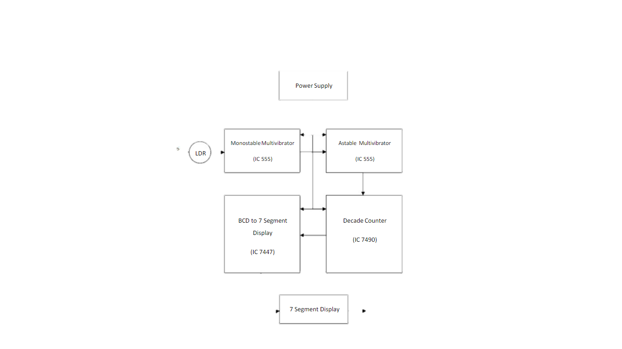
LIGHT
COUNTED OUTPUT

Slide 4
BLOCK DIAGRAM ITEMS DESCRIPTION
Power Supply: It is a 6V DC battery used to provide the Vcc supply to the ICs.
LDR: Light Dependent Resistors are used for sensing the light intensity.
Mono stable Multi vibrator: IC555 is used in mono stable mode for providing the initial pulse.
Astable Multi vibrator: IC555 is used in a stable mode for generating the clocking signals for the decade counter IC.
Decade Counter: IC7490 is a decade counter which counts from 0-9 and provides BCD output.
BCD to 7 Segment Display: IC7447 is used to convert the BCD signals into the equivalent 7 segment display signals.
7 Segment Display: Used to display the number of counts.

Slide 5
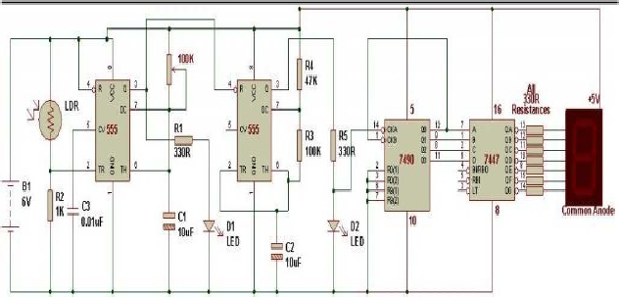
CIRCUIT DIAGRAM

Slide 6
CIRCUIT DIAGRAM DESCRIPTION
The LDR receives the light signal and acts accordingly. Whenever there is light blockage, the resistance increases and the triggering signal is given to the monostable multivibrator.
The mono stable mutivibrator generates a high signal which activates the astable multivibrator. This astable multivibrator and the other resistors provide the clocking frequency for the decade counter.
The decade counter IC7490 starts counting the signals and provides the BCD equivalent output.
This BCD output is given to the seven segment display and it thus displays the equivalent counts.

Slide 7
COMPONENTS USED
Resistors - 1k ohms, 330 ohms, 100k ohms, 47k ohms.
Capacitors 0.01uF, 10uF.
Light Dependent Resistor (LDR).
6V Battery.
Timer IC555 (2).
Decade Counter IC7490.
BCD to 7 Segment Display IC7447.
7 Segment Display

Slide 8
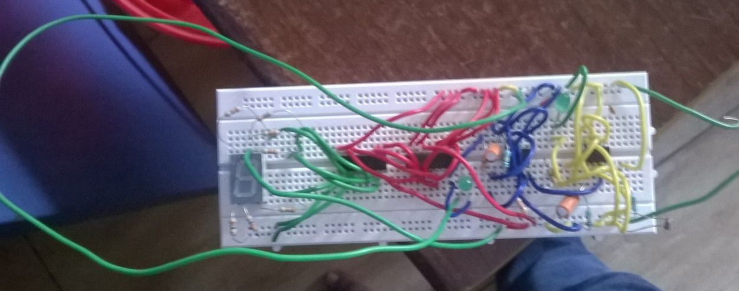
PICTURE OF THE PREPARED CIRCUIT

Slide 9
Thank You

